Slide 1


The Saline County Criminal Justice Training Center

Slide 2

Chemical Suicides
First Responder Safety

Slide 3
Course Objectives:
Upon completion of this training, attendees will be able to:
Define the hazardous nature of responding to a chemical suicide call.
List the steps in safely responding to a call involving chemical suicide.

Slide 4
Objective #1
Define the hazardous nature of responding
to a chemical suicide call.

Slide 5
Chemical suicides reported in Japan
So called “Detergent suicides” have been a recent trend in Japan, which has caused a panic amongst officials.
With 50 people having killed themselves with detergent overdose recipes found on the internet, officials have tried to get internet providers to take down pages containing the recipe.

Slide 6

Chemical suicide examples from Japan

Slide 7
Japanese Girl Commits Suicide With Detergent
April 24, 2008 (AP)
A 14-year-old Japanese girl killed herself in her bathroom by mixing laundry detergent with liquid cleanser, releasing fumes that sickened 90 people in her apartment house.
The door was closed, and she had affixed a sign on the outside warning, "Gas being emitted.”
None of the sickened neighbors in Konan, southern Japan, were severely ill, although about 10 were hospitalized.
The deadly hydrogen sulfide gas escaped from the girl's bathroom window and entered neighboring apartments.
The girl's suicide was part of an expanding string of similar deaths that experts say have been encouraged by Internet suicide sites since last summer.

Slide 8
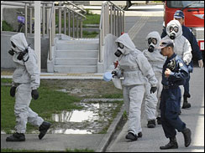
Police officers in protective gear enter the apartment where a Japanese girl gassed herself to death by mixing laundry detergent with cleanser.

Slide 9
Japan
A 31-year-old man outside Tokyo killed himself inside a car by mixing detergent and bath salts.
A local police spokesman refused to give further details, but Kyodo News agency reported the man put a sign reading "Stay Away" on the car window.

Slide 10
Japan
At a business hotel in Shiga prefecture in western Japan, a man in his 30’s was found dead by employees who noticed a strange smell coming from his room, according to national broadcaster NHK.
Shiga police said officials are investigating the incident as a case of suicide by hydrogen sulfide gas but could not elaborate.

Slide 11
Japan
Reports of another similar death emerged when the body of a 42-year-old woman in Nagoya, central Japan, was found in a bathtub.
According to Kyodo, there was toilet cleaner and bath powder nearby, along with a sign outside that read, "Poisonous gas being emitted. Caution.“
Nagoya police said they could not comment on the case, but Kyodo said that fire officials called to the scene did not detect hydrogen sulfide gas.
The method has alarmed officials because of the danger that bystanders can be hurt.

Slide 12
Japan
In Japan, a total of 32,155 people killed themselves in 2006, giving the country the ninth highest suicide rate in the world, according to the government.
"It's easy and everyone can do it," said Yasuaki Shimizu, director of Lifelink, a Tokyo-based group specializing in halting suicides.
"Also there is a lot of information teaching people how to do it on the Internet.“
Police say they have not tallied the number of detergent-related suicides, but media reports suggest it has reached about 30 this year, including several cases in which others were also sickened.

Slide 13
A warning to fire and emergency services responders
The New York Office of Fire Prevention and Control recently assisted local authorities in two communities with suicides involving chemicals.
This method of suicide, sometimes called “detergent suicide,” frequently used in Japan, is being seen more frequently in the U.S.
The process involves mixing common household chemicals to create hydrogen sulfide in a small space.
Instructions to do this are readily available on the internet and most encourage anyone planning to use this method to provide appropriate warnings to people who might encounter or respond to their situation about the presence of the deadly gas.
(November, 2009)

Slide 14
Examples of chemical suicides
In Arizona one individual manufactured hydrogen cyanide instead of hydrogen sulfide.
It may be rare because chemicals needed for the reaction are not as readily available as those used to make hydrogen sulfide.

Slide 15
Be alert for warning signs
Anyone who enters the space without proper protection may quickly become a victim.
Both recent incidents in New York involved suicides inside a vehicle.
One vehicle had very clear and obvious warning signs taped to the window (as shown in Fig. 1 and 2), the other had less noticeable signs laid on the dashboard.
In both instances responders recognized the situation and took protective actions.

Slide 16
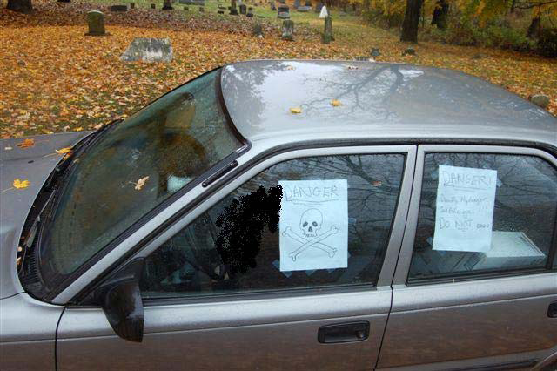
Figure 1

Slide 17
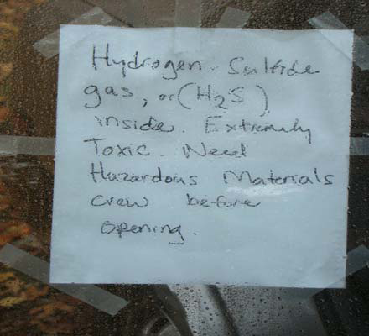
Figure 2

Slide 18
Chemical suicide - Sugar Creek Dec. 22, 2009
SUGAR CREEK, Mo. – A man used hydrogen cyanide chemicals to kill himself in a confined pickup truck.
Four responders and a family member were exposed to the toxic gases from inside the vehicle.
All five were just taken to the hospital as a precaution.
No warning note was found on the truck.
The man worked in a lab and had access to cyanide.
Two containers were found in the truck (shown in Fig. 3).
Notes:
Chemical Suicide Sends First Responders To Hospital
Suicide Uses Toxic Chemicals In Locked Cars
POSTED: 6:51 am CST December 22, 2009
UPDATED: 7:13 pm CST December 22, 2009
SUGAR CREEK, Mo. -- Four first responders on a suicide call went to the hospital after being exposed to the toxic chemicals a man used to kill himself Monday.
The man used what is called detergent suicide, using hydrogen cyanide in a confined pickup truck. The chemical released toxic gases, which the four responders and a family member were exposed to. All five were just taken to the hospital as a precaution.
Sugar Creek Fire Chief Herb Soule said detergent suicide attempts are on the rise. The trend started in Japan with hundreds of the suicides and four of the cases have been reported in the U.S.
In many of the Japanese cases, many of those committing suicide have left notes on the car warning people of the toxic gases. No note was found on the Sugar Creek truck.
"There's a question of how he ingested it," Soule said. "But the fact remains there were two containers in the car."
Soule said he first learned of the trend two weeks earlier in a memo about the rising trend. The memo stated many use hydrogen sulfide, an easily found chemical. The Sugar Creek man used a less-accessible hydrogen cyanide.
"Suicide's a tragic thing," Soule said. "If people endanger themselves, I guess we can't really stop them from doing that. But we sure don't want them endangering first responders and other people who are out there."
Soule said other first responders should be on alert for similar problems. Soule said the Sugar Creek man had access to the cyanide because he worked in a lab, but some other toxic gases can be mixed up with household cleaners.
18

Slide 19
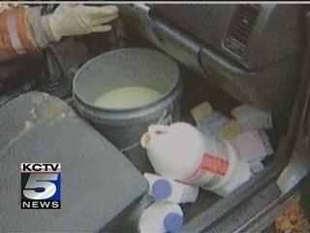

Figure 3

Slide 20
Incidents may become more frequent
It is anticipated that the number of these incidents will rise as more people become aware of the process.
The New York Office of Fire Prevention and Control developed the following guidelines to deal with these incidents.

Slide 21
Objective #2
List steps in safely responding to a call
involving chemical suicides.

Slide 22
Responding to chemical suicides
Responders should be aware that these situations commonly occur in vehicles, residential bathrooms and other small spaces where a small amount of gas can quickly reach lethal concentrations.
Dispatchers and call takers should warn callers not to approach, or enter, vehicles, rooms or apartments where unresponsive people may have attempted chemical suicide.

Slide 23
Responding to chemical suicides
Dispatchers and call takers should be alert for this type of call.
The caller may say there are warning signs on the vehicle but may not volunteer this information.
Warning signs may be removed, become detached or dislodged, or blow away before emergency personnel arrive.
The caller may not say anything about a strange smell (like rotten eggs or almonds) unless prompted when they call 911.
Proper initial questioning may yield information vital to the safety of the first responders.
The information must be immediately passed on to the first responders by the 911 personnel.

Slide 24
Responding to chemical suicides
Carefully size up any situation involving an unresponsive person in an enclosed space.
Responders should wear SCBA and turn-out gear whenever they are dealing with a suspected chemical suicide.

Slide 25
Responding to chemical suicides
Consider wind speed and direction when determining the need to evacuate nearby structures.
In an apartment building, consideration should be given to evacuating the entire building.

Slide 26
Responding to chemical suicides
If there’s a possibility the victim is sleeping, attempt to wake them with a vehicle public address system, bullhorn or siren.
If they cannot be awakened, responders should perform a thorough recon before entering the space to assist the victim.

Slide 27
Responding to chemical suicides
Individuals who initiate chemical suicide may, or may not, place warning signs on doors or windows to indicate the presence of deadly gas inside the space.
Signs may not be easily detected or understood by other people – including responders!
Signs may be hidden or obscured by condensation, frost, snow, or vapors produced by the reaction.

Slide 28
Responding to chemical suicides
Interview anyone who may have approached the scene to learn what they saw or smelled.
A “rotten egg” smell would indicate hydrogen sulfide.
An almond odor is typical of cyanide compounds.

Slide 29
Responding to chemical suicides
Look for indications a chemical reaction has been initiated.
Typically you will find containers of household chemicals and pails, buckets, pots or other containers where the chemicals have been mixed.
Improvised “containers”, such as a sink or the glove box of an automobile, could be used to mix the chemicals.

Slide 30
Responding to chemical suicides
If you can clearly see there are no chemical containers and mixing containers present anywhere in the space, it is probably not a chemical suicide.

Slide 31
Responding to chemical suicides
If chemical containers are present, attempt to identify the chemicals from labels or a sales receipt.
The reaction utilizes an acid, such as muriatic or hydrochloric found in many common cleaning compounds, and a sulfide present in many fungicides, paints, insecticides, and shampoo to produce Hydrogen Sulfide.

Slide 32
Responding to chemical suicides
The presence of containers of potassium cyanide, or cyanide compounds would indicate a reaction that produces hydrogen cyanide.
This is less common than the hydrogen sulfide reaction as the cyanides are not as easily obtained.

Slide 33
Responding to chemical suicides
Air sampling equipment can be used to determine the presence or absence of hydrogen sulfide or hydrogen cyanide.
A small hole may be punched in a car or home window, or a probe, or colorimetric tube inserted in the gap between a door to the room and the floor.
A hydrocyanic acid tube will detect hydrogen cyanide.
Hydrogen sulfide is heavier than air, but hydrogen cyanide is slightly lighter.

Slide 34
Responding to chemical suicides
If the vapor in the space cannot be identified, or the presence of hydrogen cyanide is confirmed entry should only be made by individuals protected by fully encapsulated chemical protective clothing (level A).
Hydrogen cyanide is immediately dangerous to life and health at concentrations above 50 parts per million.

Slide 35
Responding to chemical suicides
Both hydrogen sulfide and hydrogen cyanide are flammable.
The Lower Explosive Level of hydrogen sulfide is 4% and the LEL of hydrogen cyanide is 5.6%.
There have been no incidents of fire reported with these incidents.
It is believed that concentrations do not typically reach the LEL except at close proximity to the mixing container.
Responders should eliminate ignition sources whenever possible.

Slide 36
Responding to chemical suicides
Vapors inside the space should be ventilated to the outside.
Ensure no one will be endangered by the vapors before using natural or forced ventilation to air the space out.
Anyone who has been exposed to the vapors should be decontaminated with soap and water.

Slide 37
Responding to chemical suicides
Clothing should be removed and double-bagged.
Contaminated clothing and PPE should be laundered before being re‐used.
If alive, the victim should be stripped and decontaminated with soap and water before being transported from the scene.
Deceased victims should be covered by a sheet.
Body bags are not recommended.

Slide 38
Chemical suicide hazards in emergency rooms
Man’s Vomit Poisons 54 People
By Mui Mui on May 22, 2008
In Kumamoto, Japan, a man was rushed to the emergency room after poisoning himself by drinking large amounts of pesticide.
Doctors were attempting to pump the patient’s stomach when he started violently vomiting before dying.
The spray of chloropicrin, a very dangerous pesticide, was so toxic it cause 54 doctors, nurses, and patients to have breathing problems and sores in their eyes, leaving them desperate for medical help.
All of the injured hospital workers were transferred to a different hospital and 10 of them ended up being hospitalized themselves.
A 72 year-old pneumonia patient got the worst of it as her condition worsened after being exposed to the fumes.
90 additional hospital personnel were called in to assist in the emergency and the nearby fire department was called in to decontaminate the emergency room.
Source: Weird Asian News.com

Slide 39

Other Chemicals:
Paradichlorobenzene poisoning

Slide 40
Paradichlorobenzene poisoning
Some vacuum cleaners have an attachment for killing bugs.
The attachment holds moth crystals (Paradichlorobenzene, pronounced “para-di-chloro-benzene”)
This attachment will convert your vacuum sweeper to exterminate insects (spiders, roaches, ants, etc.).
Anything that can walk or crawl.

Slide 41
What do the instructions say?
One vacuum instruction book says:
How to use the crystalator:
Warning: Follow directions and cautions on label of crystal container.
Keep crystals out of reach of children.
Crystals may be harmful if taken internally.
Do not breathe the concentrated gas from the crystalator.
Do not enter a treated closet until it has ventilated.
Do not remain in a treated room until gas concentration is reduced to safe level.
If eye, throat, or skin irritation occurs, do not remain in treated area.
Return unused crystals to closed container and seal tight. In the crystalator, use only 100% pure paradichlorobenzene with U.S.D.A. registration number on the container.

Slide 42
Paradichlorobenzene poisoning
Paradichlorobenzene is a white, solid chemical with a very strong odor.
Poisoning can occur if you swallow this chemical or inhale it in a gaseous form.
Where Found - Toilet bowl deodorizers and Moth repellant. (not all-inclusive).

Slide 43
Paradichlorobenzene poisoning
Symptoms:
  Burning in mouth
  Breathing problems (rapid, slow, or painful)
  Cough
  Shallow breathing
  Changes in alertness
  Headache
  Slurred speech
  Weakness
  Yellow skin (jaundice)
  Abdominal pain
  Diarrhea
  Nausea
  Vomiting

Slide 44
Paradichlorobenzene poisoning
Emergency Room Care
The health care provider will measure and monitor the patient's vital signs, including temperature, pulse, breathing rate, and blood pressure.
Symptoms will be treated as appropriate. The patient may receive:
Activated charcoal
Fluids through a vein (by IV)
Laxative
Medicines to treat symptoms
Tube through the mouth into the stomach to wash out the stomach (gastric lavage)

Slide 45
Paradichlorobenzene poisoning
Outlook (Prognosis)
This type of poisoning is usually not life threatening. Little will likely happen if your child accidentally puts a moth ball in the mouth, even if swallowed, unless it causes choking.
Mothballs have an irritating smell, which usually keeps people away from them.
More severe symptoms may occur if someone intentionally swallows the product, since larger amounts are usually swallowed or fumes inhaled.

Slide 46
Could a person use this to kill their self?
I think so, don’t you?
It certainly sounds like it could be harmful.
First responders should take the same precautions discussed earlier if they are at a scene where someone has been the victim of this type of poison, whether accidental or not.

Slide 47

Time for Questions

Slide 48
Acknowledgement
The initial information for this presentation was
provided by The New York State Office of Fire
Prevention & Control, Hazardous Materials/
Homeland Security Bureau.
http://www.dos.state.ny.us/fire/firewww.html
November 6, 2009
And, to Les Kerr, Law Enforcement Coordinator for
the U.S. Attorney, Western District of Missouri for
sharing the information with me and others.

Slide 49
This presentation prepared by:
James Simmerman, Director of Training
and
Director of Creative Management Consultants
Saline County Criminal Justice Training Center
Saline County Sheriff’s Department
1915 West Arrow Street
Marshall, Missouri 65340
660-886-5512
www.salinecountysheriff.com (website)
james.simmerman@att.net (e-mail)

